Slide 1
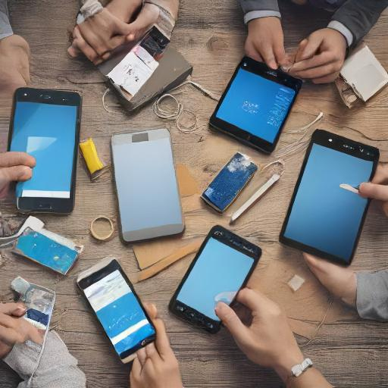
Accessibility (mobile phones and tablets)
What accessibility features do you use on your phone or tablet?
DeepAI
u3a computing and digital group
15:10:2024

Slide 2

Accessibility
Accessibility ensures that everyone, regardless of their abilities, can access and benefit from technology and other resources.
Vision: Tools like screen readers, magnifiers, and high-contrast themes help people with visual impairments.
Hearing: Features such as closed captions, mono sound, and live call transcription assist those who are deaf or hard of hearing.
Mobility: Voice commands, eye control, and adaptive accessories support individuals with mobility challenges.
Neurodiversity: Tools like dictation, immersive readers, and focus aids help people with cognitive differences such as dyslexia or ADHD
using copilot

Slide 3
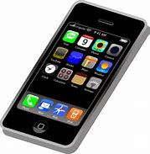
Android
TalkBack: A screen reader that provides spoken feedback.
Magnification: Allows users to zoom in on any part of the screen.
Voice Access: Enables control of the device using voice commands.
Live Caption: Automatically captions speech on your device.
Switch Access: Lets users interact with the device using switches instead of the touchscreen
using copilot

Slide 4
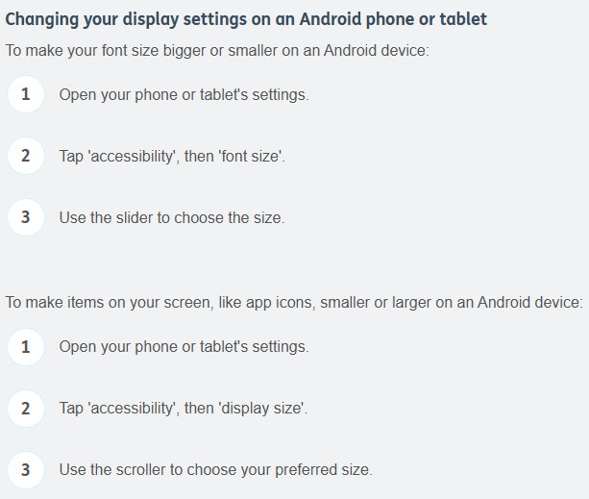
Age UK
https://www.ageuk.org.uk/information-advice/work-learning/technology-internet/device-accessibility/

Slide 5
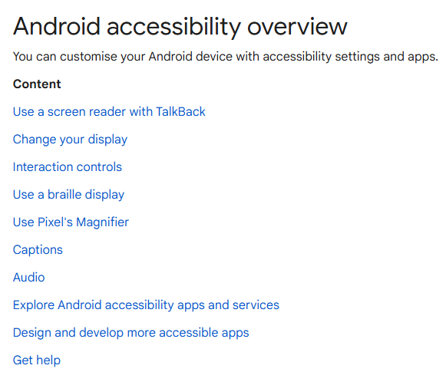
Google Support
Android Accessibility Help
https://support.google.com/accessibility/android/answer/6006564?hl=en-GB

Slide 6
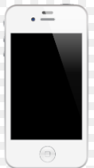

iOS
Accessibility - Apple (UK)
Mobile phones and tablets come with a variety of accessibility features designed to help users with different needs. Here are some key features for iOS devices:
VoiceOver: A screen reader that describes what’s happening on your screen.
Zoom: A built-in magnifier that works anywhere in iOS.
Siri: Apple’s voice assistant that can perform a variety of tasks.
AssistiveTouch: Helps users with motor skill impairments by providing on-screen touch alternatives.
Live Listen: Uses your iPhone as a remote microphone for your hearing aids
using copilot

Slide 7
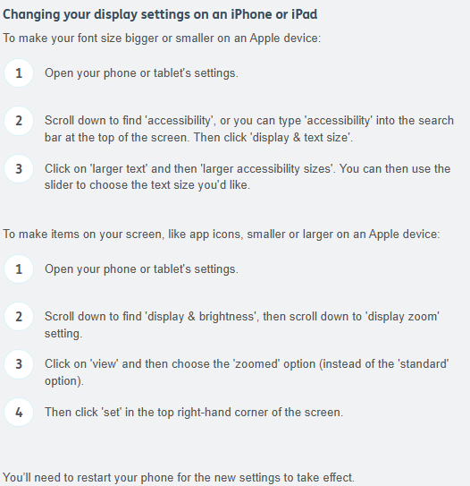
Age UK
https://www.ageuk.org.uk/information-advice/work-learning/technology-internet/device-accessibility/

Slide 8
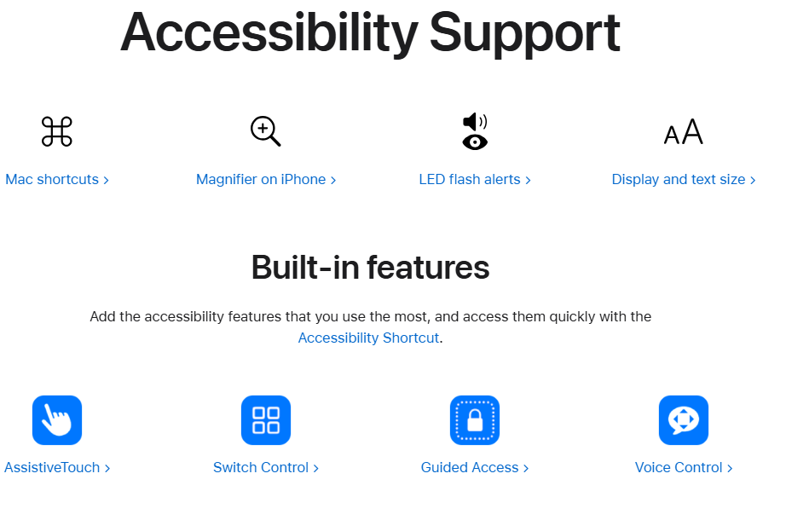
https://support.apple.com/accessibility

Slide 9

Adapting devices for easy use
Help with seeing the screen
Help with hearing calls and audio
Help with controlling the device
Easy-use gadgets and devices
https://www.independentage.org/get-advice/technology/accessible-devices

Slide 10
useful websites
https://www.independentage.org/get-advice/technology/accessible-devices
https://www.ageuk.org.uk/information-advice/work-learning/technology-internet/device-accessibility/
https://www.understood.org/en/articles/assistive-technology
https://www.scope.org.uk/advice-and-support/accessibility-apps
https://www.guidedogs.org.uk/getting-support/information-and-advice/how-can-technology-help-me/tech-for-all-learning-programme/
https://youtu.be/X47mjVa81pg?si=JO10UaOXQr2yTH4s Android 20 mins
https://youtu.be/JNpQTPR6SeI?si=hnF8V9tPmUC1gonb iPhone 12 mins
https://support.google.com/accessibility/android/answer/6006564?hl=en-GB
https://support.apple.com/en-gb/guide/iphone/iph3e2e4367/ios
https://support.apple.com/accessibility
https://mcmw.abilitynet.org.uk/
https://www.ageuk.org.uk/information-advice/work-learning/technology-internet/device-accessibility/

